Slide 1
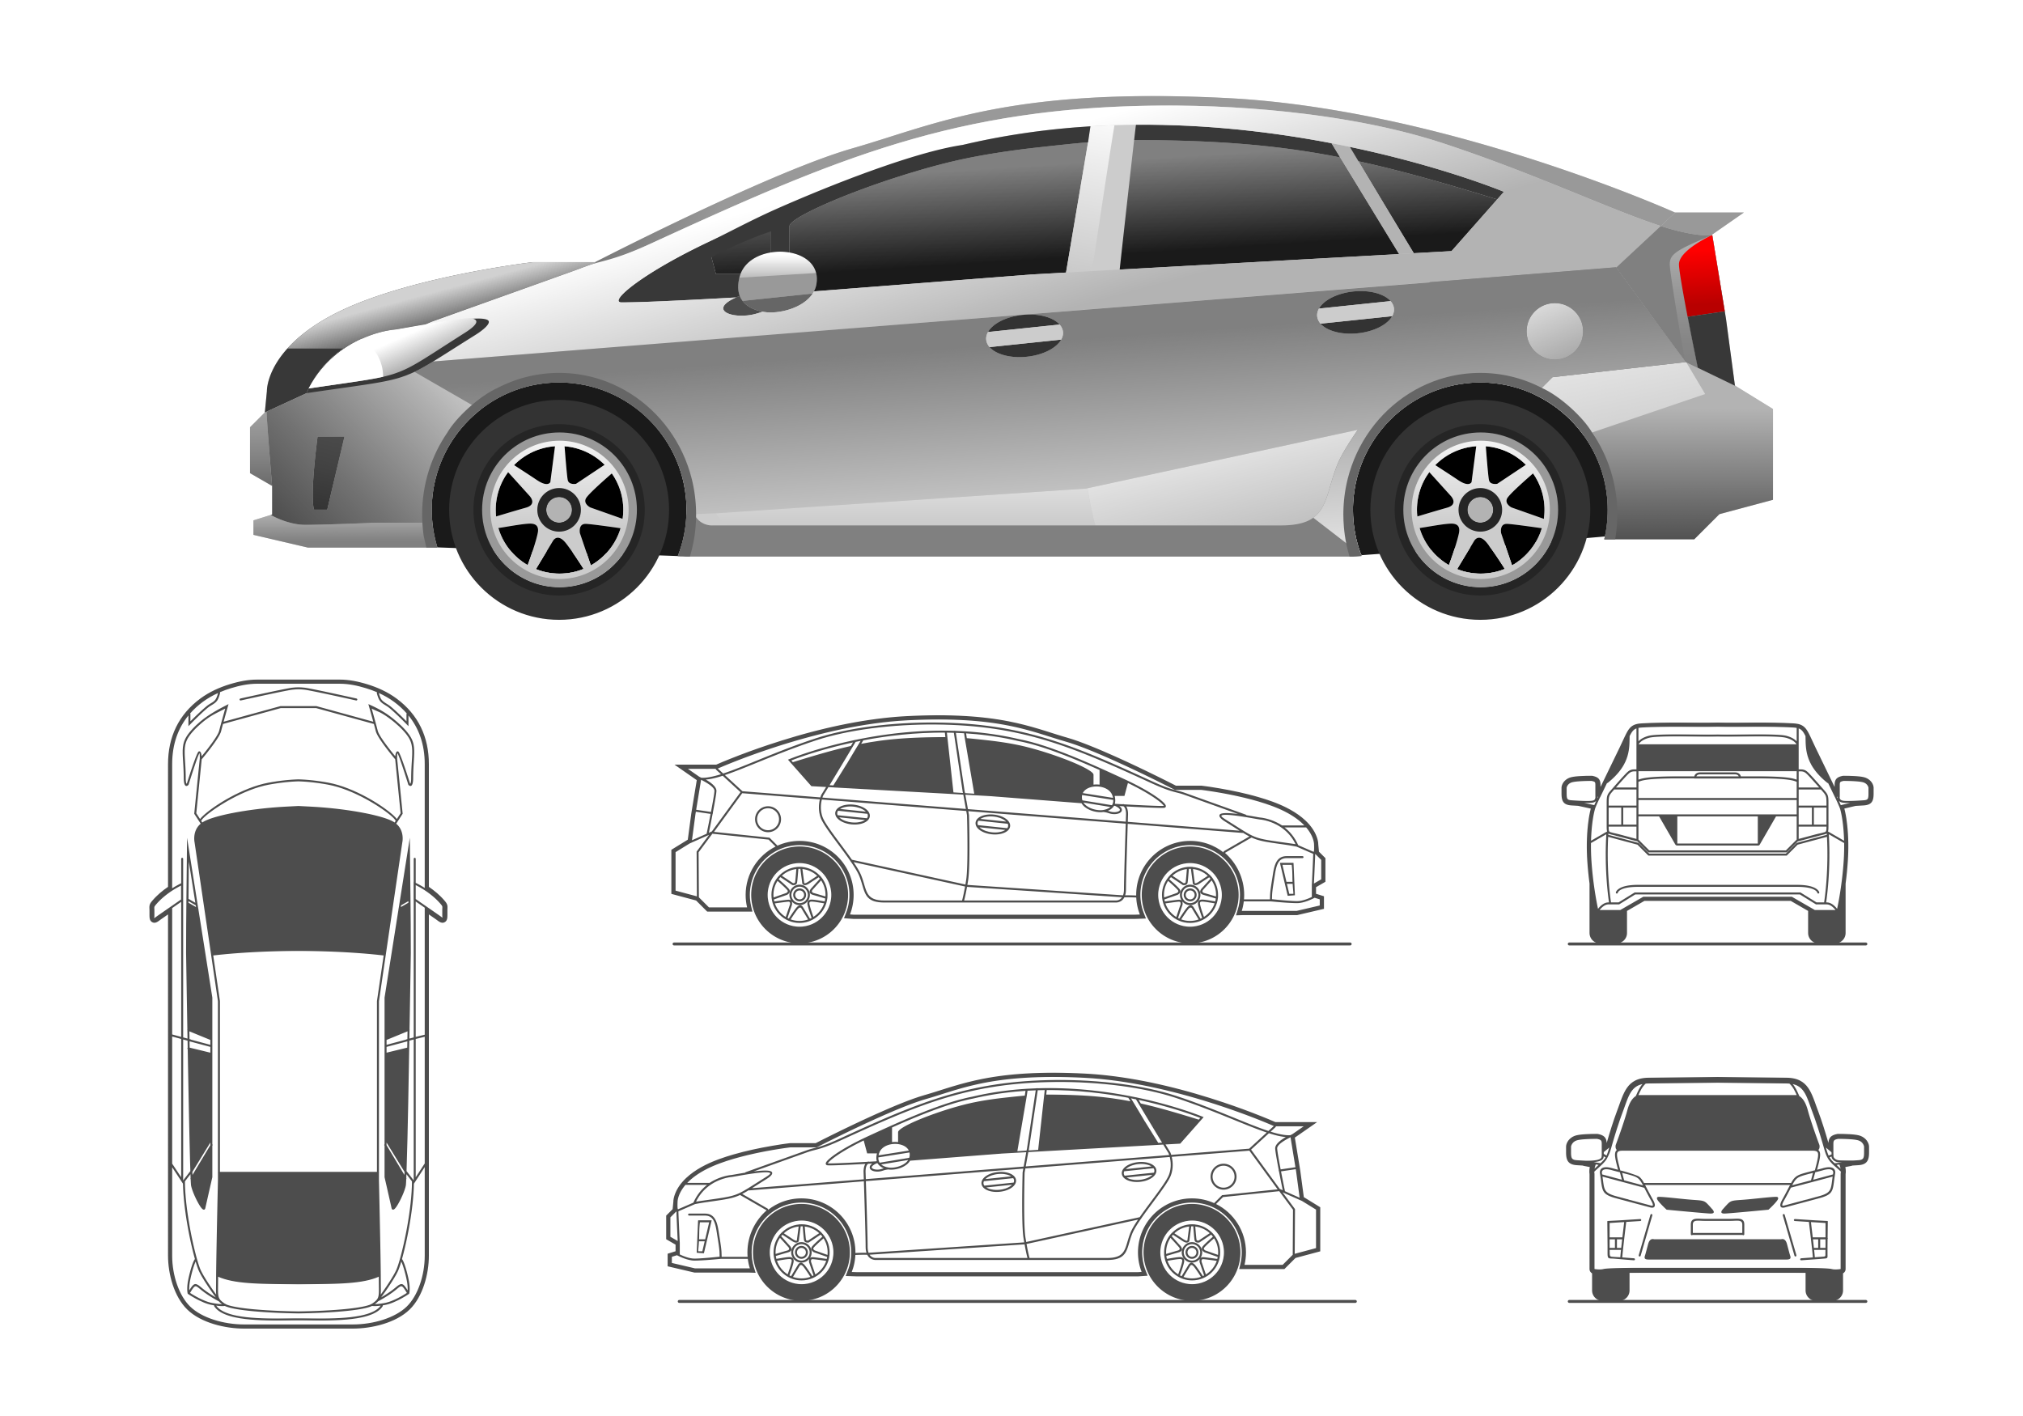
Charging Bay₁
Charging Bay_{N}
EV Charging Station
EV Charging Station
EV Charging Station
…
Wind Turbine Generator
AC/DC
OR
…
OR
Solar PV (MPPT)
DC/DC
Battery Swapping Station
…
Battery Swapping Station
Grid
Inverter
DB
DB
Delivery of Battery Pack
Delivery of Battery Pack
Auxiliary Loads
Inverter
FB₁
FB₁
…
…
FB_{N}
FB_{N}
Bidirectional DC/DC
Battery Storage
Battery Storage
…
DC-Bus
BESS₁
BESS_{N}
Charging Power
Station System
Notes:
Assume:
Li-Ion battery
Battery information is provided
Charging station has limits and parameters (what should these be?)
Fast/Slow
Cost to charge
Specification of battery should be known
Can we build optimization for battery swapping with game theory conrtorls
Compare with MDP, and Fluid, and Game Theory (Jacobian,Hamilton)?
Use the demand curves provided by the reference literature
Cost optimization
Issues for charging customer oriented
Parameters:
Demand Curve / Events
Time to swap
Number of Batteries in Inventory
Charging Rates for batteries
Capacity of each battery
Cost of charging at any time (demand price)
How many batteries will I need to at the beginning of the day? Given a specific demand each day? Dynamic pricing that changes on demand or cost of charge.
What is the problem with standardization
Charging tationsneed standards
Swapping doesnthave standards

Slide 2
Charging Bay
Battery Swapping Station
Charging
System
Grid
DB
AC\DC
Delivery of Battery Pack
Battery Charger
FB₁
…
FB_{N}
Notes:
Assume:
Li-Ion battery
Battery information is provided
Charging station has limits and parameters (what should these be?)
Fast/Slow
Cost to charge
Specification of battery should be known
Can we build optimization for battery swapping with game theory conrtorls
Compare with MDP, and Fluid, and Game Theory (Jacobian,Hamilton)?
Use the demand curves provided by the reference literature
Cost optimization
Issues for charging customer oriented
Parameters:
Demand Curve / Events
Time to swap
Number of Batteries in Inventory
Charging Rates for batteries
Capacity of each battery
Cost of charging at any time (demand price)
How many batteries will I need to at the beginning of the day? Given a specific demand each day? Dynamic pricing that changes on demand or cost of charge.
What is the problem with standardization
Charging tationsneed standards
Swapping doesnthave standards

